Slide 1
SMS Spam Classification
Using spam.csv dataset from kaggle
Group Members
Kunal Mallick(24167002)
Soham Adhikari(24167029)
Anushka Khatua(24167030)
Akankhyaa Abhisikta Lenka(241670XX)

Slide 2
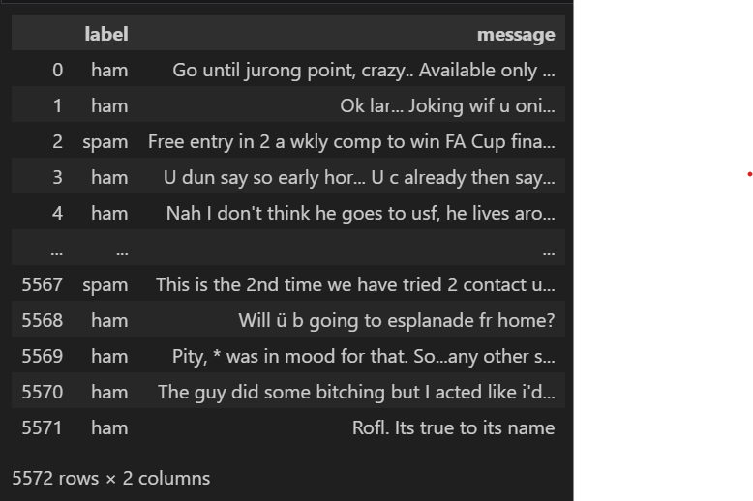
Dataset Overview
Source:
Kaggle - spam.csv
Size:
5,572 rows, 2 columns
Columns:
label (ham or spam)
message (sms content)

Slide 3
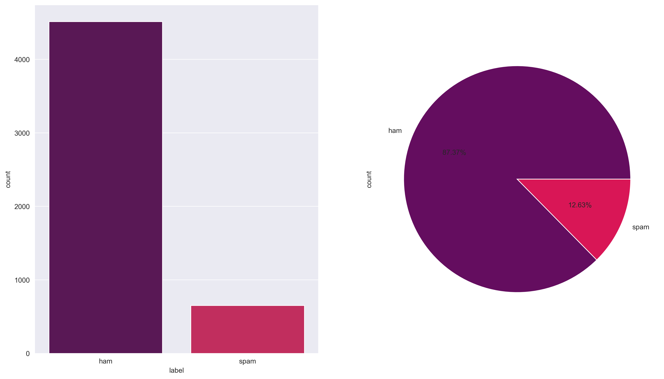
Spam vs Ham Distribution
Spam: 13.4% (747 messages)
Ham: 86.6% (4,825 messages)
Imbalance: Majority of the messages are ham

Slide 4
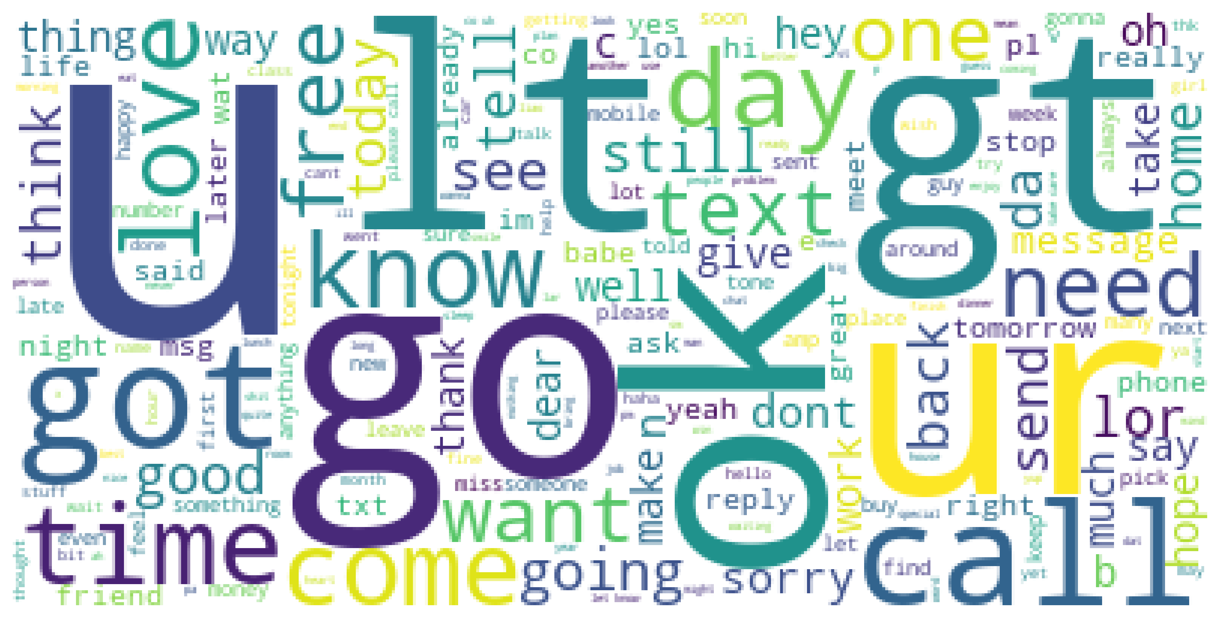
Data Insights
Top Words
Spam: "win", "free", "call"
Ham: "ok", "good", "know"

